Slide 1
ThinkItThru!
a project by Jensen Schmidt, Levi Wright, and Zachary Travis

Slide 2

Is this you?
Most students find themselves:
stressed
behind on work
unable to track and manage tasks
have trouble concentrating on work
image: freepik.com

Slide 3
Overview

Slide 4
Goals
To help students:
organize work
break down assignments
work on personal goals
motivate students
To eliminate:
stress
bad study habits
forgotten assignments
procrastination

Slide 5
Overview
organization and time management website
Create “tasks” to complete
divide into manageable goals
daily and weekly
spendable rewards
logging in
completing goals and tasks

Slide 6
Tasks

Slide 7

Types of Tasks
Scheduled task
estimated time to complete
difficulty and priority
Recurring task
creates a weekly goal to achieve

Slide 8
Task Prioritization
Time
total or with subtasks
Difficulty
affects hours worked per day
Priority
inflexibility
affects task list

Slide 9
Additional Options with Tasks
Daily Tasks:
Early Complete
Full Complete
Editable
Removeable
Total Task Layout:
Editable
Full Complete
Removeable

Slide 10
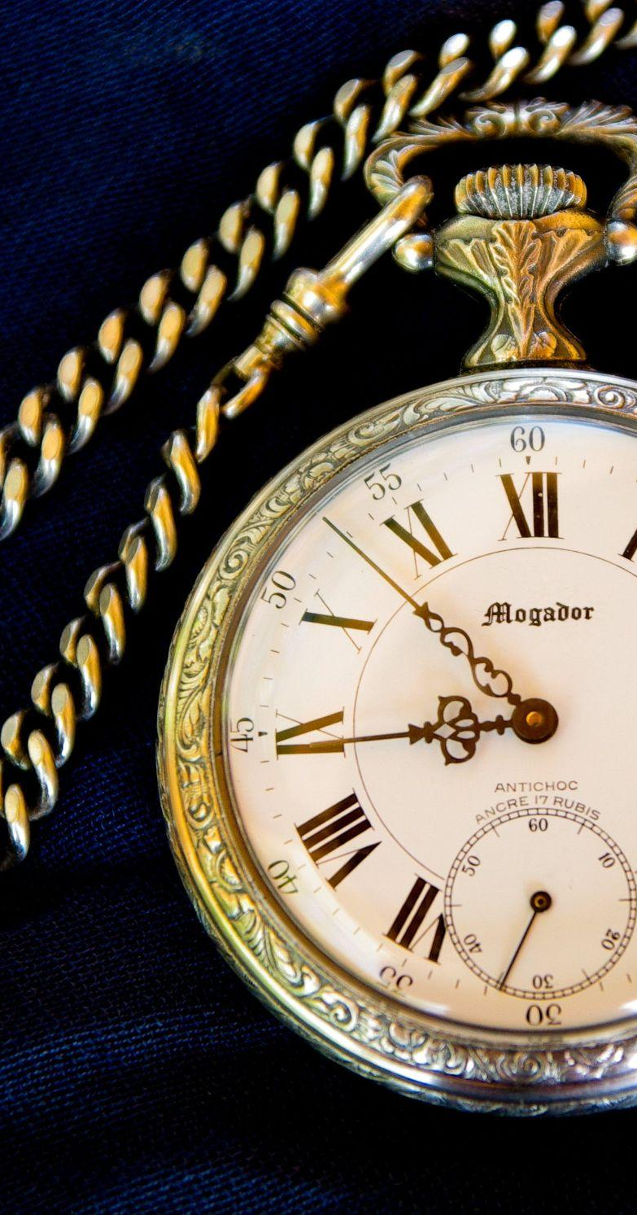
The Pomodoro Technique
Productivity increased by setting a timer
work time
break times
balance
source: https://todoist.com/productivity-methods/pomodoro-technique

Slide 11
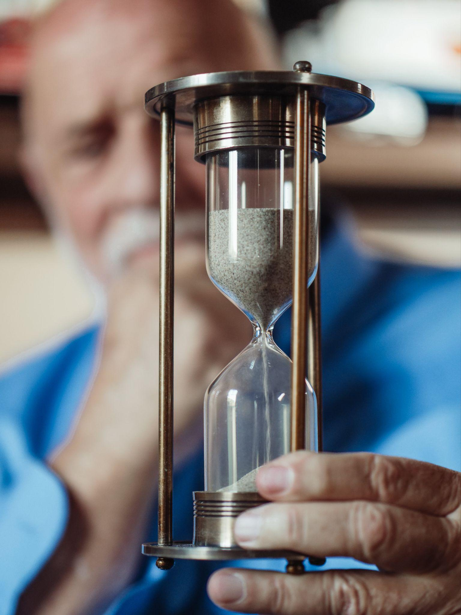
“Clock in” / “Clock out”
amount of time worked on a task
concentrates attention
breaks included
“clock out” at end of work

Slide 12

Task Creation
name
date due or recurring
hours estimated
subtasks
difficulty
priority
range of work time

Slide 13
Objectives System

Slide 14
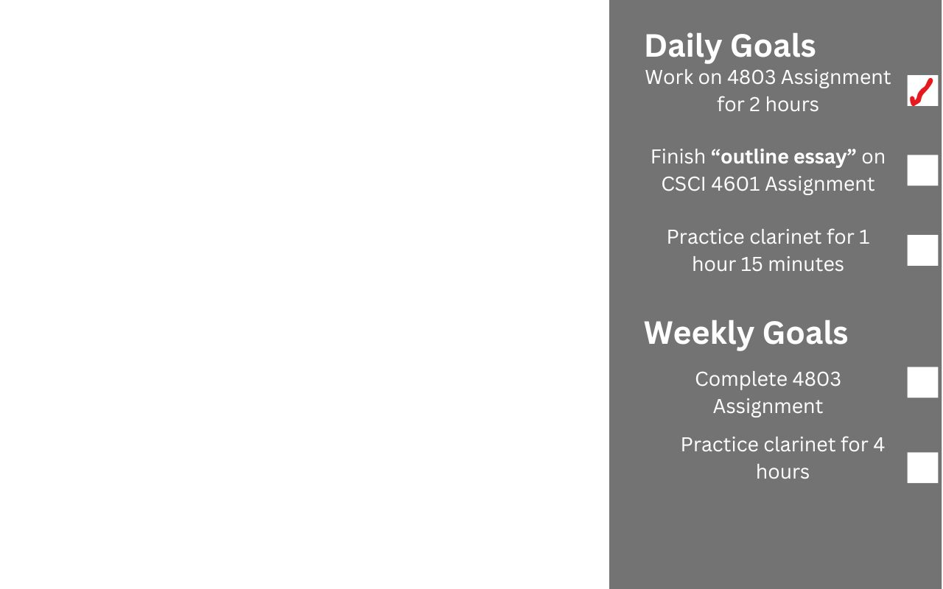
Daily and Weekly Objectives
Daily objectives
short-term
minimalistic
divided work
(not representative of the final product)
Weekly overview
complete goals
finish what is due
combination of daily objectives

Slide 15
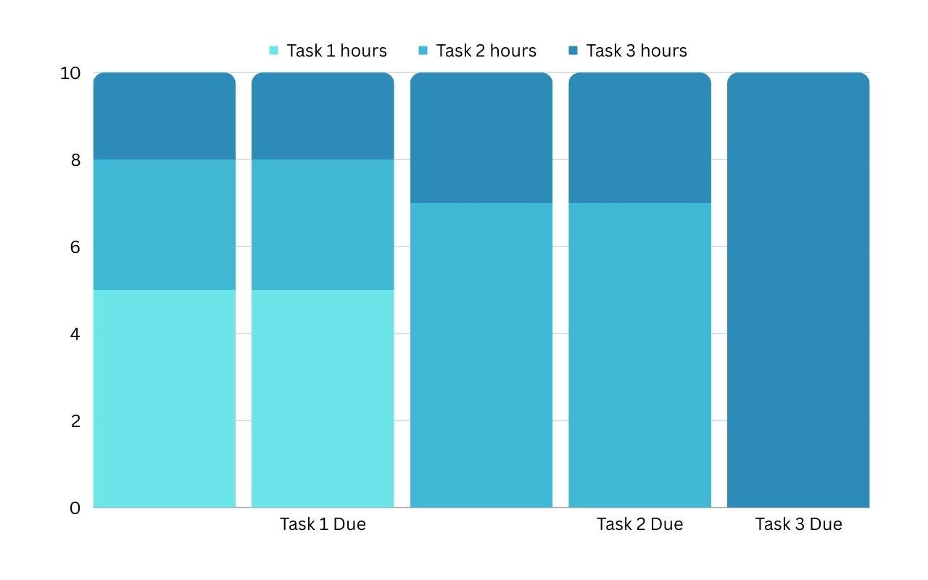
Automatic Work Breakdown
(Not representative of final product)

Slide 16
Stats

Slide 17

Hour Logging and Tracking
Daily logging:
individual tasks
hour division
Weekly logging:
past year
user progression

Slide 18
Rewards

Slide 19

Experience
Based on difficulty
Per minute of work
Completing daily tasks
Completing weekly overview items
Fully completing tasks
Logging in

Slide 20

Mind Your Garden
Decorate with points
Small items
Multi-tile items

Slide 21

Items
Single use
limited time xp bonus
Game items
garden decoration = more experience

Slide 22
Profile

Slide 23
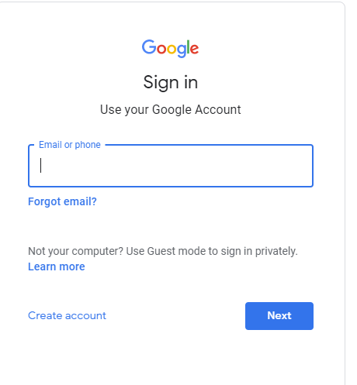
Login System
Sign up
input validation
password verification
Sign in
database matching
Sign-in with Google

Slide 24
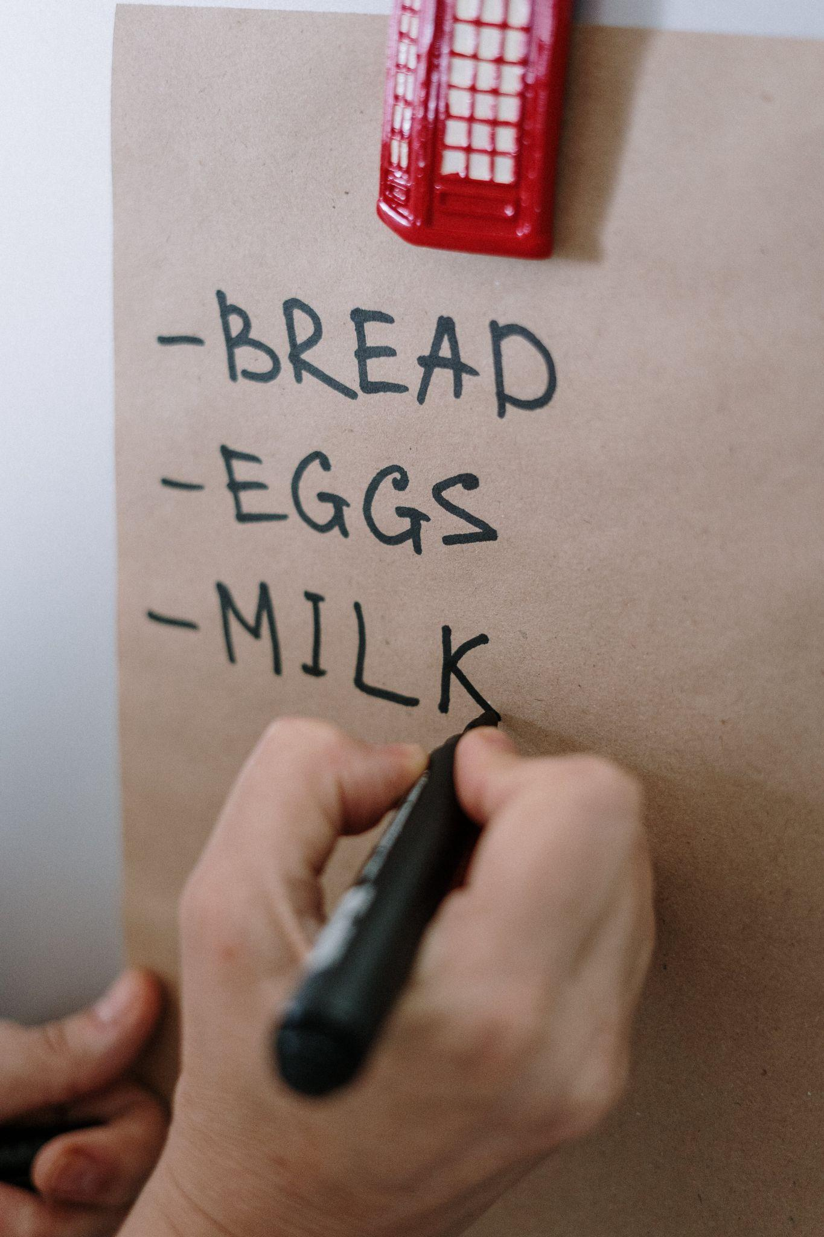
Profile Required Attributes
At sign-in/registration:
Name
Password
E-mail
(exception to this: Federated)
Major
In the backend:
Assigned statistics

Slide 25
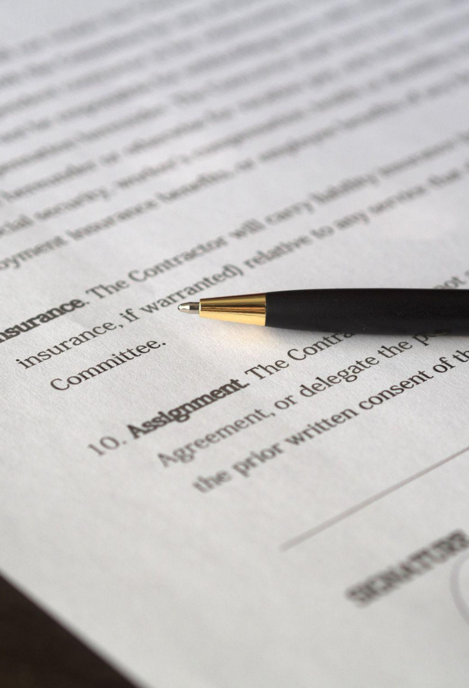
Registration Form
All the required statistics
If federated, but no data
Creates the user
Validation
Password status

Slide 26

Additional Profile Option and Login
Additional Profile Option:
Profile Pictures
Login:
Daily “first login”
Login Streak
Affected by items

Slide 27
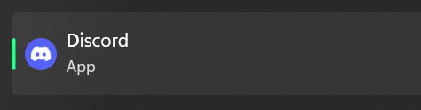
Social
Discords
Possibilities of more
Stored in database

Slide 28
Thanks for Listening!

